Slide 1

COFFEE QUALITY ANALYSIS
-Coffee Quality Institute
-by: Nikhil Kumar Sharma
(S9663)

Slide 2
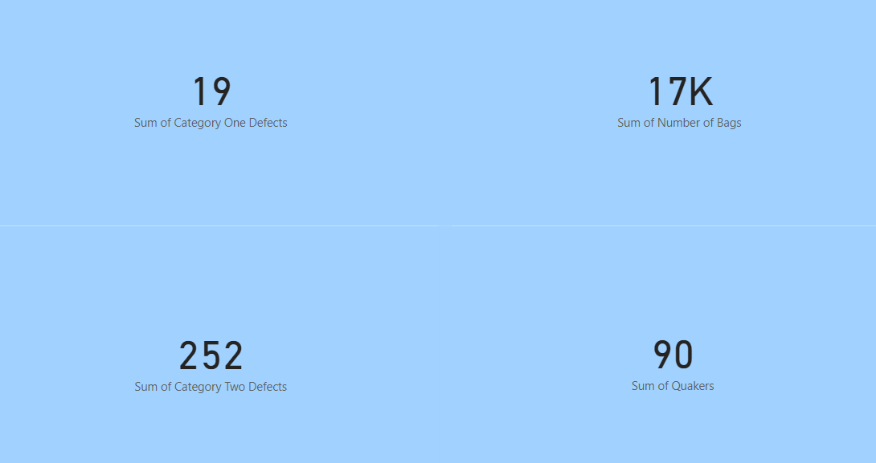

Slide 3
What are the key determinants of coffee quality as evaluated through sensory attributes such as aroma, flavor, acidity, etc.?
The top 5 sensory attributes contributing to the maximum cup points are:
Clean Cup.
Sweetness.
Uniformity.
Flavour.
Aroma.

Slide 4
Is there a correlation between processing methods, origin regions, and coffee quality scores?
There is a significant effect on overall coffee total cup points by sensory attributes such as Acidity, Aroma, Body, Balance, Clean Cup, Sweetness, etc.
Regions of high altitude produce coffee with better quality.

Slide 5
Can we identify any trends or patterns in defect occurrences and their impact on overall coffee quality?
Sum of Category 2 defects are more as compared to the sum of category 1 defects.
Double Carbonic Maceration / Natural processing method has the maximum number of Category 2 defects.
Washed / Wet processing method has maximum number of Category 1 defects.
December and February months have least defected coffee beans.
March and April months have maximum number of defected coffee beans.

Slide 6
How do different variables interact to influence the Total Cup Points, which represent an overall measure of coffee quality?
The sensory attributes such as Acidity, flavour, aroma, body, sweetness etc have a significant effect on overall Total Cup scores. Thus, improvement in this attributes increase the overall score of the coffee.
The beans prepared by Washed / Wet, Natural /Dry, Pulped Natural processing methods have high cup points.
The top 3 countries with highest total cup points are:
Colombia.
Taiwan.
Honduras.

Slide 7
Top 3 varieties having highest total cup points are:
Castillo.
Gesha.
Java.

Slide 8







